Slide 2
Company Overview
Language services since 2010 with over 120 languages available
Certifications
  California DGS Certified Small Business #1760600
  State of California Contractor CMAS # 4-18-0717A
  National Veteran Business Development Council # FT04212201800376
  National Minority Supplier Development Council #SC17543
Customers include California Highway Patrol, CA Public Utility Commission, CA Energy Commission, LA County, Department of State Hospitals, Office of State Publishing, California High Speed Rail & Foster Farms

Slide 3

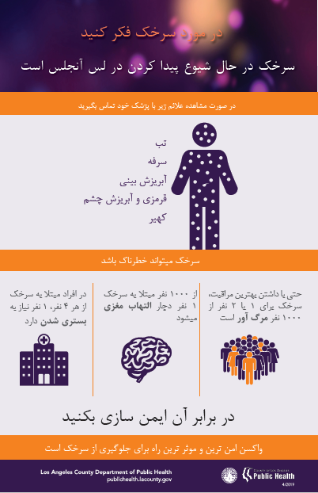
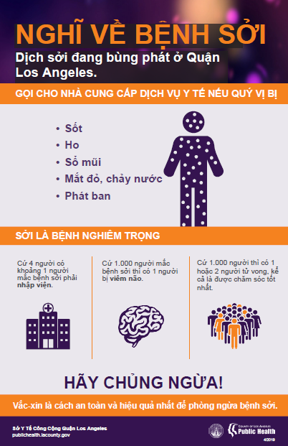
Written Translation
Documents
Transcription
Captions
Client: Los Angeles County

Slide 4
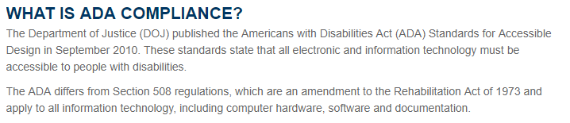
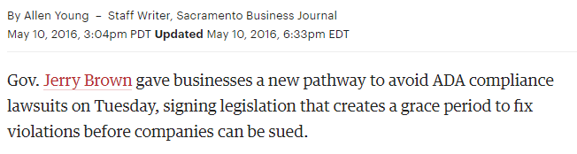
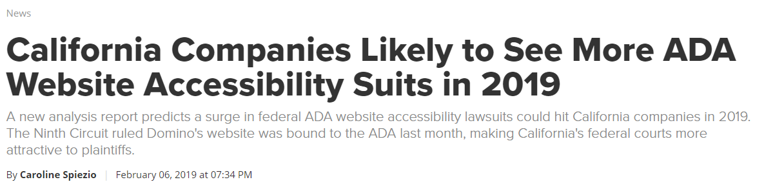
American Disabilities Act (ADA) Compliance
Translations
Electronic Records
Websites

Slide 5
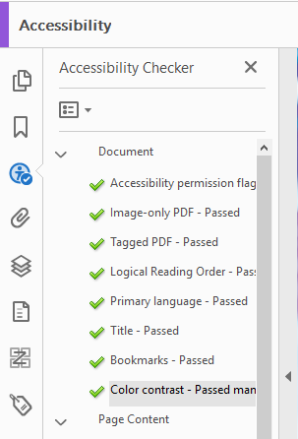
American Disabilities Act (ADA) Compliance
Translations
Electronic Records
Websites
Before
After
Client: Office of State Publishing

Slide 6
Over the Phone (OPI) Interpreting
  80 languages available
  24/7 call center. Connects in 4 rings or less.
  Reporting metrics available
    Call date, interpreter number, contact name, Limited English Proficient Speaker (LEP) name, Number/Dept, Language, Call Start & End times, Call length, Rate per minute, Customer Account Number
  Features
    3-way calls, client support, back up number, recording available for customer service
  3 step process to connect
    Dial toll free number
    Use menu to select interpreter language & enter code
    Field rep enters customer account number. Gives live agent their ID number and name

Slide 7
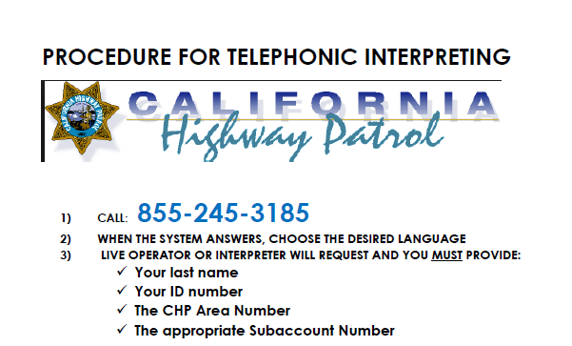
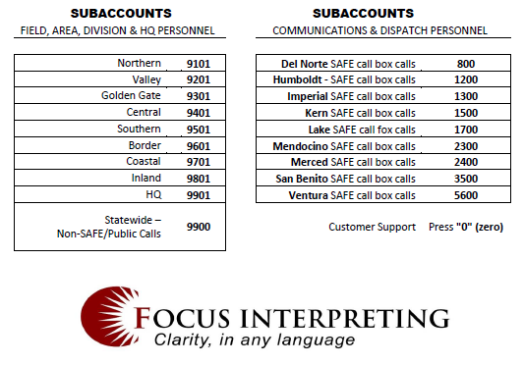
Telephonic Interpreting Process
Client: CA Highway Patrol

Slide 8
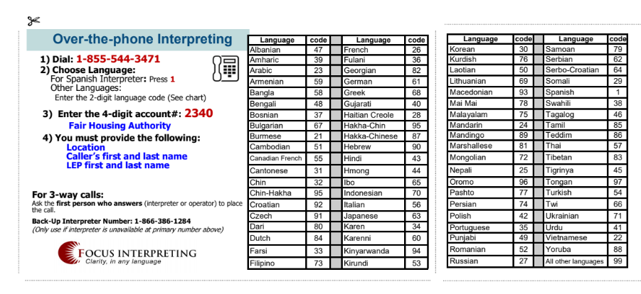
Telephonic Interpreting Languages
Client: Fair Housing Authority

Slide 9

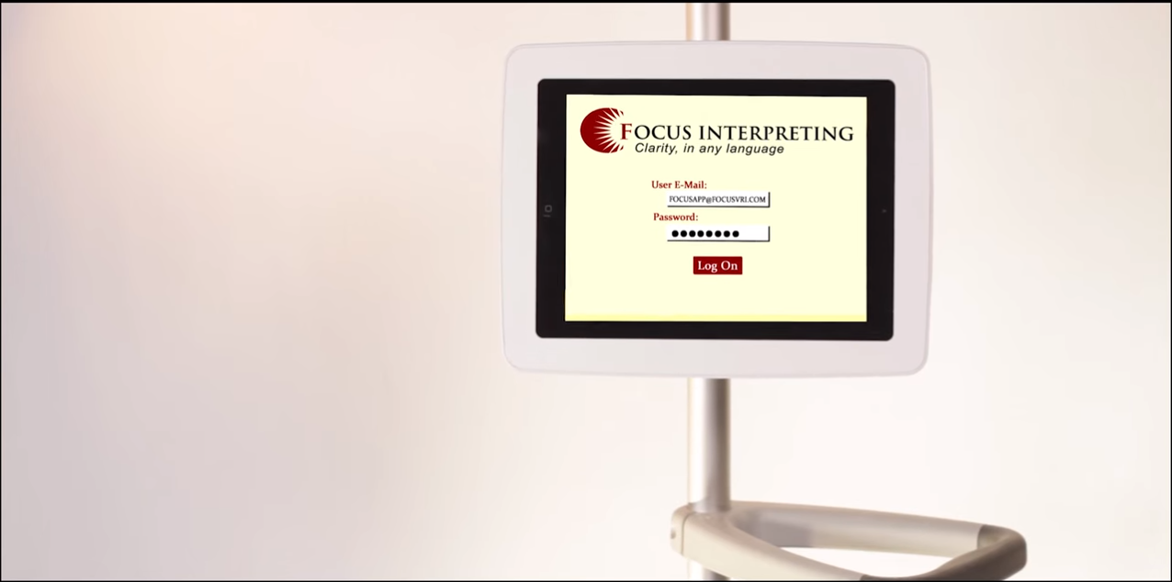
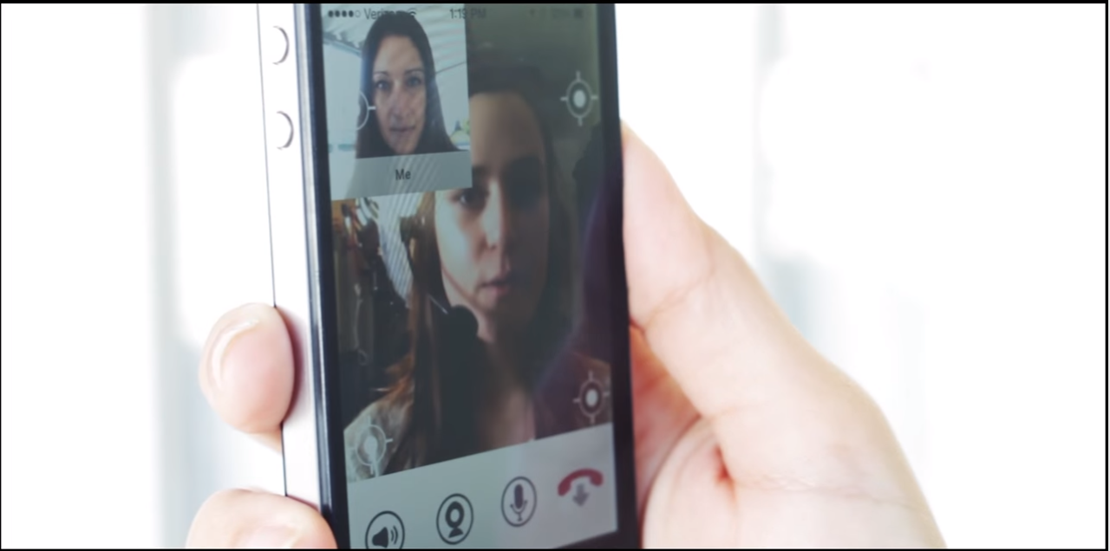

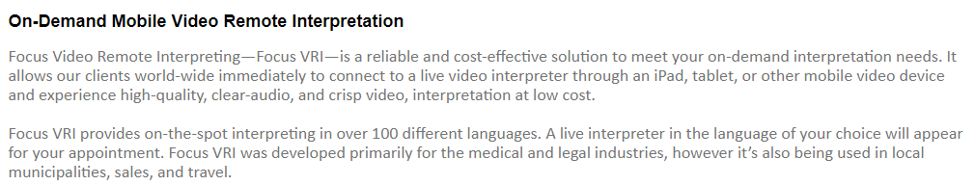
Focus VRI (Video Remote Interpreting)
  Video Demo: https://www.youtube.com/watch?time_continue=24&v=2XXiV9-3G7c

Slide 10
On Site Interpreters
One on One
Conferences
Public Hearings

